Slide 1
Employee Data Analysis using Excel
STUDENT NAME:
REGISTER NO:
DEPARTMENT:
COLLEGE
D.DHANALAKSHMI
312216765
B.COM ACCOUNTING ANA FINANCE
SHRI KRISHANASWAMY COLLEGE FOR WOMEN

Slide 2
PROJECT TITLE
Employee Performance Analysis using Excel AND EMPLOYEE DATA ,EXCEEDS

Slide 3


AGENDA
Problem Statement
Project Overview
End Users
Our Solution and Proposition
Dataset Description
Modelling Approach
Results and Discussion
Conclusion
3/21/2024 Annual Review

Slide 4

PROBLEM STATEMENT
WHY THIS ANALYSIS AND
2. TO CREATE SOME DATAS

Slide 5

PROJECT OVERVIEW
.WHAT IS THAT PARTICULAR ANALYSIS .SHORT INTRO
DATE ANALYSIS AND EXCEEDS

Slide 6
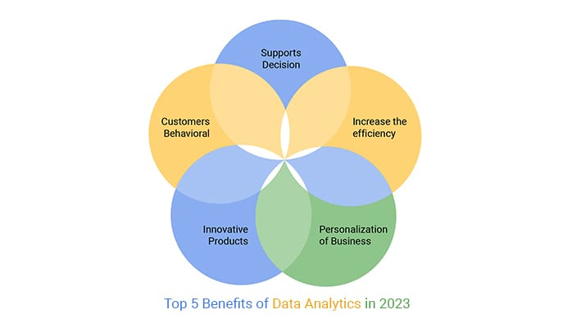

WHO ARE THE END USERS?
WHO ARE THE BENEFICIARIES OF THAT ANAYSIS

Slide 7

OUR SOLUTION AND ITS VALUE PROPOSITION
One solution and its value technique and its value.
Like pivot tables , conditional formatting etc.,
Explain where you used in detail .
Like specify the column and row used.

Slide 8

Dataset Description
Where it was imported from total features and features considered for
Analysis list the features shortlisted and used in excel.
Give as sentence.

Slide 9

THE "WOW" IN OUR SOLUTION
Segment our data.
Quantity of data .
performance of our categories by data analysis.
3/21/2024 Annual Review
9

Slide 10
EMPLOYEE DATA ANALYSIS
MODELLING
Data collection----cleaning----visualization—etc.,
10

Slide 11
RESULTS
11

Slide 12
conclusion
Interpretation of result in verbal form & reveal your
Finding from the analysis.

